Slide 1


PRESENTATION
GROUP PROJECT...
LEAN SYSTEM

Slide 2







GROUP MEMBERS
TAHSEEN TASIM
2125051056
SHAKIBUL ALAM
2125051093
AHMED BAPPY
2125051080
NAHIYAN RASEL
IQBAL HOSSAIN
2125051054
NAHIYAN RASEL
2125051072
NAFIUL BHUIYAN

Slide 3


TABLE OF CONTENTS
Introduction
evolution of Lean thinking
Lean Principles and Applications
Tools and Techniques
Six sigma
Service operations
Supply chain management
Challenges and Barriers
JIT production
Culture and employee engagement
Role of Leadership

Slide 4
INTRODUCTION
Lean operations management is a process that focuses on minimizing waste and maximizing value within an organization. In other words, it is a continuous improvement methodology that is designed to help organizations improve their performance by reducing waste and increasing efficiency. Lean management facilitates shared leadership and responsibility; continuous improvement ensures that every employee contributes to the improvement process. Inspired by Toyota’s production system, Lean Management is a management and work organisation method aimed at improving a company’s performance.

Slide 5
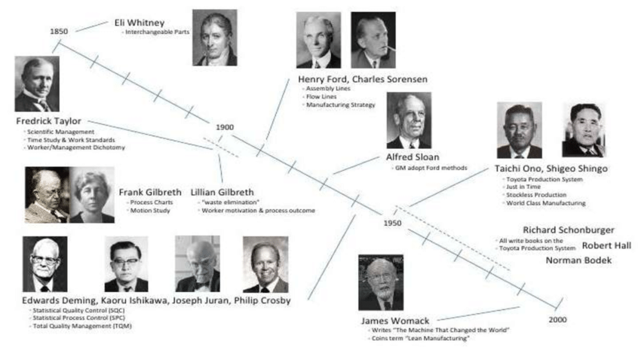
Evolution of Lean Thinking
In 1913, Henry Ford invented flow production using interchangeable parts, standard work, and moving conveyance. While he managed to turn in inventories every few days, he struggled to provide variety, limiting the Model T to one specification. The Toyota Production System introduced self-monitoring machines, and quick setups, and notified each process step of its current needs for materials to obtain low cost, high variety, high quality, and very rapid throughput times to respond to changing customer desires.

Slide 6

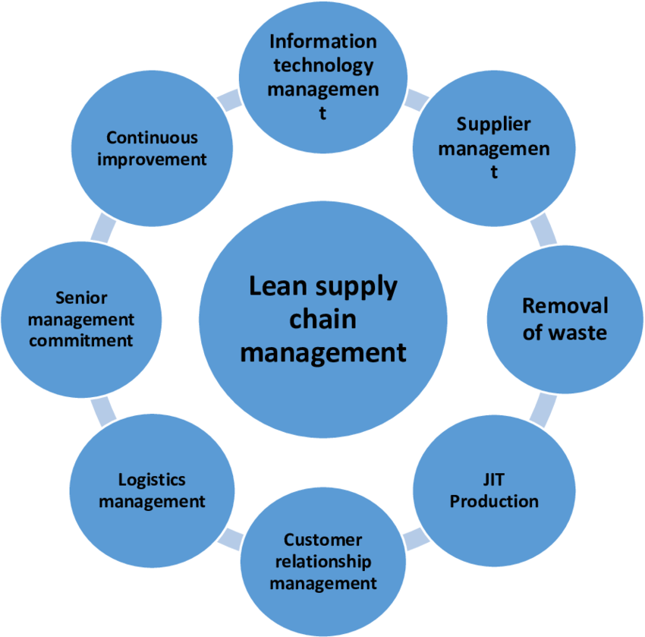
LSCM
LEAN SUPPLY CHAIN MANAGEMENT
Lean Supply chain Management draws its principles from the manufacturing philosophy pioneered by TOYOTA in the 1950s.
The goal is to deliver maximum value to customers while minimizing resources, time, costs.
Includes...

Slide 7

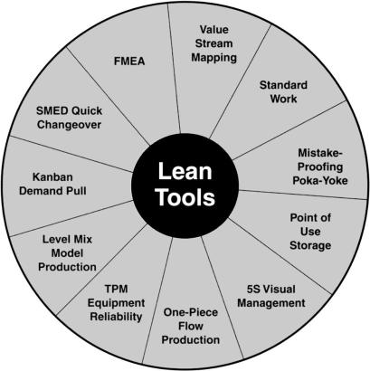
LEAN TOOLS
Value stream Mapping
Standard work
Mistake proofing
Point of use storage
5s visual management
TPM equipment reliability
Level Mix Model production
Kanban
SMED Quick changeover
FMEA

Slide 8

PRINCIPLES AND APPLICATIONS
Continuous Improvement (Kaizen)
Means always looking for ways to make things a little bit better, step by step
Eliminating Waste
Means finding and getting rid of things that don't add value for the customer, like extra inventory, waiting, or mistakes
Just-in-Time Production
Means making only what's needed, when it's needed, to reduce extra stuff sitting around
Respecting People
Means empowering and involving employees at all levels to help improve the company

Slide 9

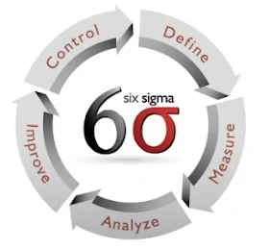
SIX SIGMA
Lean Six Sigma is a team-focused managerial approach that seeks to improve performance by eliminating resource waste and defect. It is a combination of Lean methodology and Six Sigma strategy. Lean methodology was established by Japanese automaker Toyota in the 1940s. Its purpose was to remove non-value-adding activities from the production process.

Slide 10

01
Embrace Change
02
Leadership commitment
Overcoming Challenges in Implementing Lean Systems
03
Empower Your Team
04
Cultural Alignment
05
Resource Constraints

Slide 11
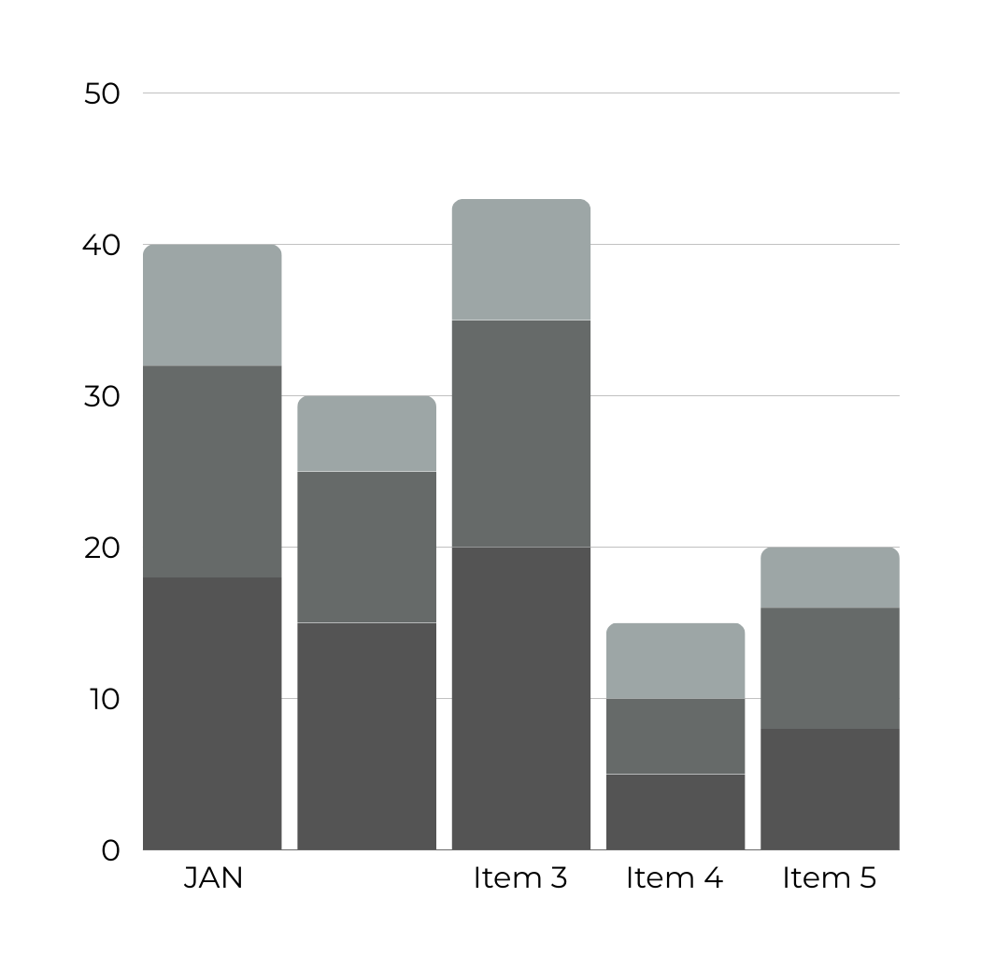


LEAN SERVICE OPERATIONS
Lean manufacturing has been around for quite sometime. Even before we got to know what Toyota was doing, manufacturing companies have been practicing many of the tools and techniques of Lean.

Slide 12



THE ROLE OF LEADERSHIP
Leadership plays a crucial role in implementing lean systems within an organization.
INCLUDES...
1. *Vision Setting*
2. *Change Management*
3. *Commitment*
4. *Empowerment*
5. *Resource Allocation*
6. *Measurement and Feedback*
7. *Role Modeling*

Slide 13
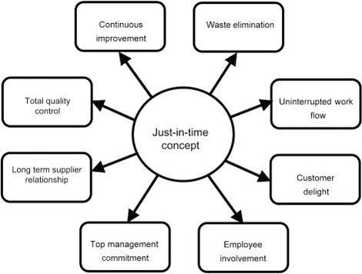

JIT-Production

Slide 14

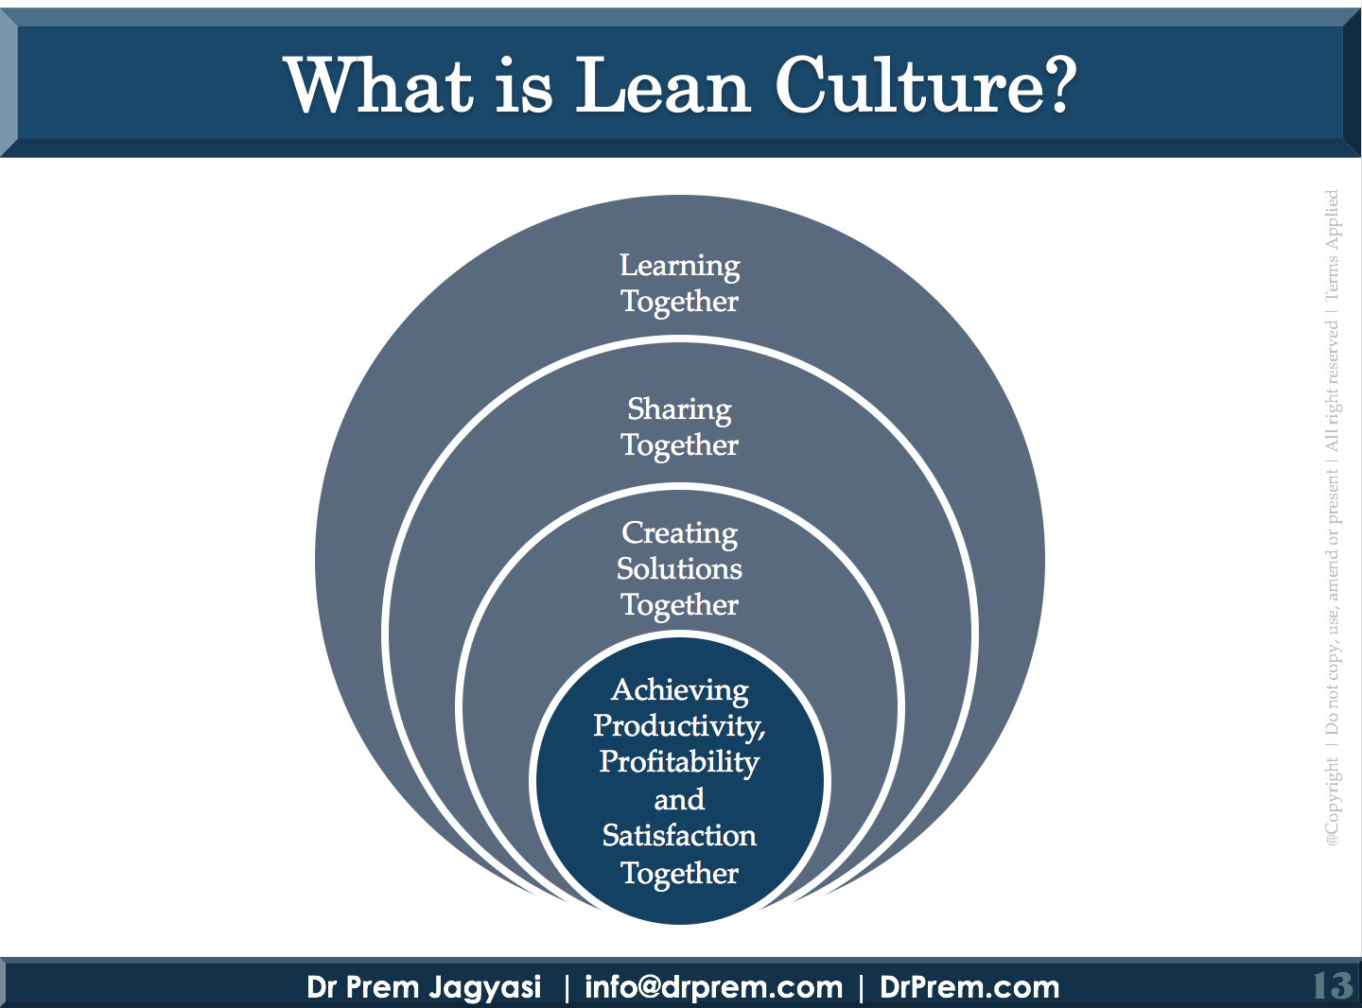
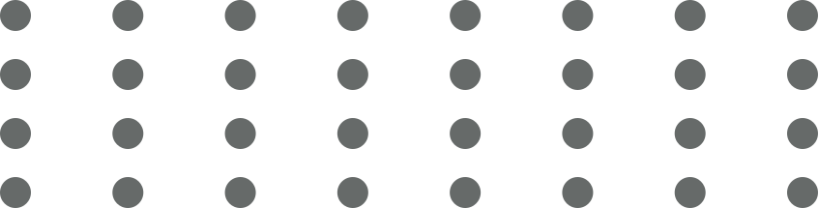

Slide 15

Mastering the art of simplifying complexity is crucial for A successful business management.
THANK YOU...

